Slide 1
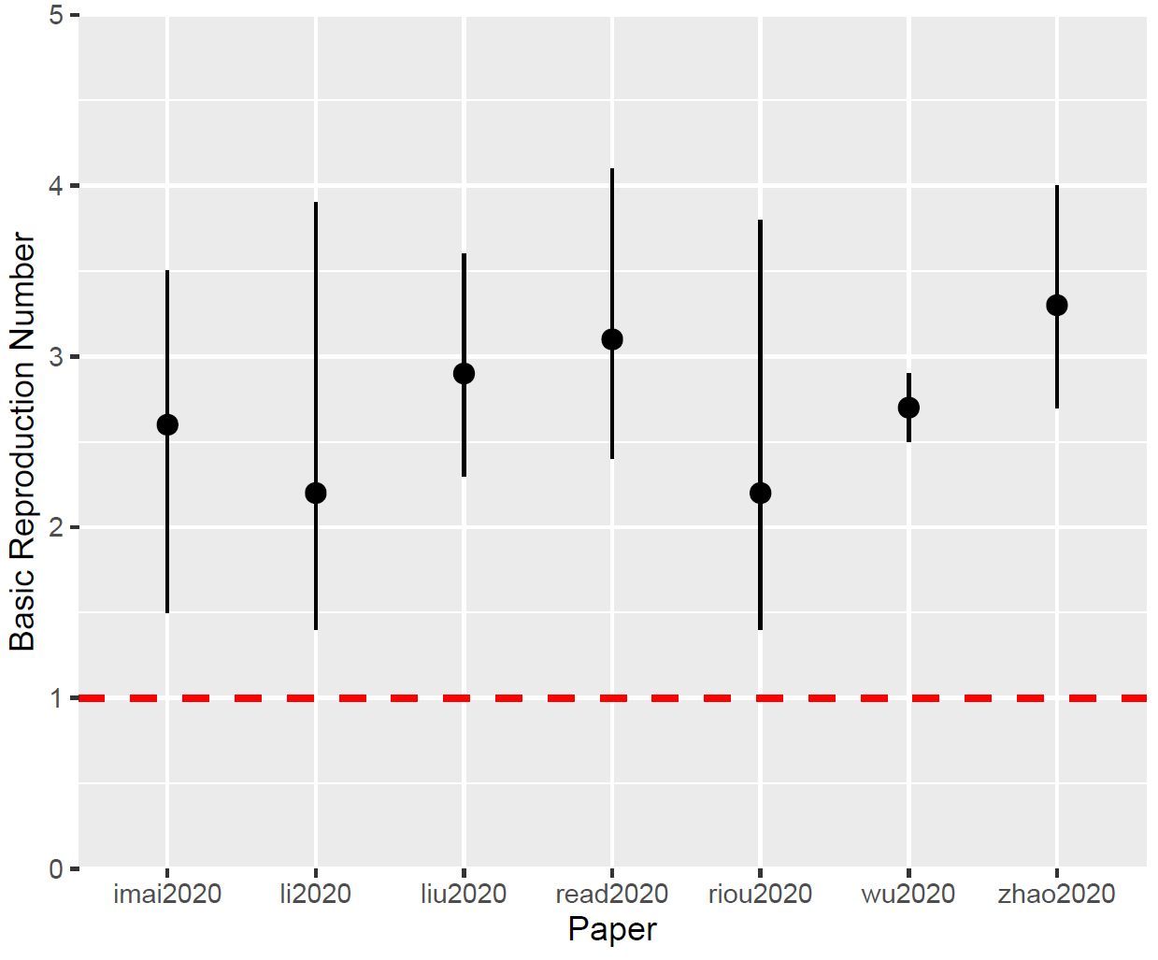
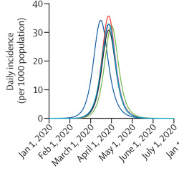
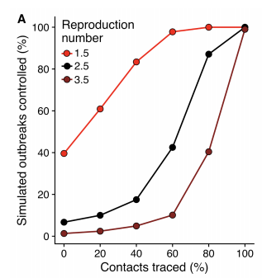
Uses of Mathematical Models during the COVID-19 Outbreak
Calculating important disease parameters
Forecasting and “nowcasting” outbreak progression
Assessing the efficacy of proposed interventions
Determine the R₀, R_{t}, serial interval, case fatality rate etc.
“Nowcasting” – (Imai et al, 2020)
“We estimate that a total of 1,723 cases of 2019-nCoV in Wuhan City (95% CI: 427 – 4,471) had onset of symptoms by 12th January 2020.”
Efficacy of Mobility and “Transmissibility” Reductions (Wu et al, 2020)
“…a 50% reduction in inter-city mobility would have a negligible effect on epidemic dynamics”
“…if transmissibility was reduced by 25% in all cities domestically, then both the growth rate and magnitude of local epidemics would be substantially reduced”
January Estimates for R₀ – Data from @sdwfrost
Forecasting – (Wu et al, 2020)
“…if there was no reduction in transmissibility, the Wuhan epidemic would peak around April, 2020, and local epidemics across cities in mainland China would lag by 1–2 weeks…”
Efficacy of Case Isolation and Contact Tracing (Hellewell et al, 2020 - Preprint)
“…R0 of 2.5 and 3.5, more than
70% and 90% of contacts respectively had to be traced to control the majority of outbreaks.”
Notes:
Not mutually exclusive – some of these are interlinked together

Slide 2

Limitations of Models for Outbreak Response
An actual epidemiologist:
Predictions are limited by the quality/availability of surveillance data.
Underreporting of cases
Rapid sequencing of viral genomes will improve this…
Predictions driven by underlying model assumptions.
e.g - Asymptomatic Transmission?
“Informative” estimates for model parameters
Potential misinterpretation of model results.
Predictive models must focus on testing different assumptions and scenarios to account for uncertainty
Caveats with interpretation of disease parameters:
R₀ – Large heterogeneity across populations (e.g - superspreaders)
Contains no information on severity and effect of interventions over the course of outbreak (R_{t}) .
Initial estimates often very varied (related to data quality).
Notes:
when emergence happened (~early Dec, helps serial interval calc),
how many times it happened (~1),
where imported infections are from (& helps spatial estimates).
SAR is high and R0 is fairly low, it suggests that transmission is driven by relatively few (potentially easily definable) contacts.
Sar is the secondary attack rate the proportion of susceptible contacts that the initial case infects in this particular setting,

